Slide 1
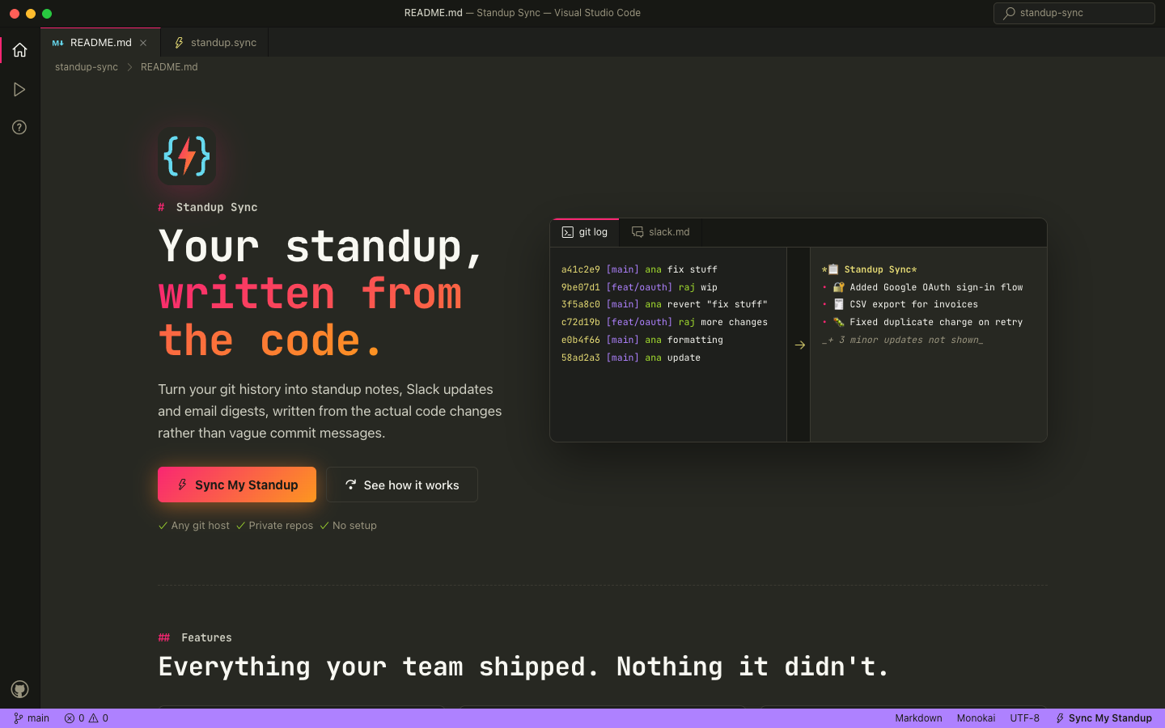
IBM Bob 2.0 Hackathon · Sept 2026
Standup Sync
Your standup, written from the code.
Reads the actual code changes in a git repo and writes Slack, Email and Standup updates for developers and for clients.
standup-sync.onrender.com
Notes:
Hi, I'm Don. This is Standup Sync. It writes your standup, your Slack update and your client email from what actually changed in the code, not from commit messages. Built for the IBM Bob 2.0 Hackathon, and it's live at standup-sync.onrender.com.

Slide 2
## The problem
Every update starts with git log
$ git log --oneline
a41c2e9 fix stuff
Commit messages don't say what got done.
9be07d1 wip
3f5a8c0 revert "fix stuff"
So developers open diffs, jump between branches and piece the week together by hand, before every standup, Slack post and client email.
c72d19b more changes
e0b4f66 formatting
58ad2a3 update
Standup Sync · IBM Bob 2.0 Hackathon
02
Notes:
This is a real week in a lot of repos. "fix stuff", "wip", a revert, "formatting". None of it says what was delivered. So before every standup or update, developers dig through diffs and branches to reconstruct their week by hand.

Slide 3



## Why it hurts
Slow, error-prone, repeated
Slow
Error-prone
Repeated
Reading diffs across every branch just to recall what changed.
Unmerged branch work gets forgotten. Reverts and formatting get reported as progress.
The same week rewritten for the team, the Slack channel and the client.
Standup Sync · IBM Bob 2.0 Hackathon
03
Notes:
Three costs. It's slow: you read diffs across branches just to remember. It's error-prone: feature-branch work gets forgotten, while reverts and formatting show up as "progress". And it's repeated: the same week gets rewritten for the team, for Slack, and again for the client.

Slide 4
## The solution
One click, six ready-to-post updates
1
Paste a repo URL. GitHub, GitLab, Bitbucket, Azure DevOps. Private repos with a token.
Format | Kept to
Slack | 3–6 short bullets
Email | 300 words, 2–4 sections
Standup | 3 lines per person
2
Pick a range. Last 24 hours to 30 days, or custom dates.
3
Press ⚡ Sync My Standup. Watch each step run live.
Each one twice: for developers (files, functions) and for clients (plain English).
Standup Sync · IBM Bob 2.0 Hackathon
04
Notes:
Standup Sync turns that into three steps: paste a repo, pick a range, press sync. You get Slack, Email and Standup versions, each in a developer version with file and function names, and a client version in plain English. Six ready-to-post updates, with strict length limits so they stay short.

Slide 5
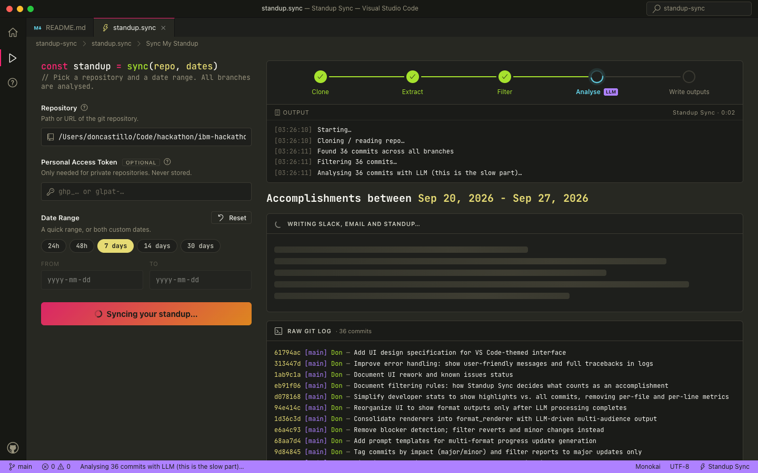
## The app
Feels like your editor
Live progress. Five steps and an OUTPUT log, as the work happens.
Raw log first. Every commit, tagged with its branch, within seconds.
Then the updates. Toggle developers and clients, copy in one click.
Standup Sync · IBM Bob 2.0 Hackathon
05
Notes:
The app is built to feel like VS Code, where developers already live. Here it's mid-run on this project's own repo: the tracker shows each step, the output log shows what's happening, and the raw git log appears within seconds, tagged by branch. Then the updates arrive, with a developer and client toggle and one-click copy.

Slide 6

## How it works
Five steps, only two use AI
no LLM
no LLM
LLM
no LLM
LLM
Git repo
Noise filter
Read the diffs
Highlights
Outputs
Every branch in your date range
Drops merges, lock files, spacing-only changes, reverts
One line per commit, tagged MAJOR or MINOR
Major updates only, by area and author
Slack, Email, Standup for developers and clients
The model only sees commits that survive the filter: noise is dropped before any AI runs, and a typical run costs cents.
Standup Sync · IBM Bob 2.0 Hackathon
06
Notes:
Under the hood: five steps, and only two use the LLM. We pull commits from every branch, filter out the noise in plain code, then the model reads each diff, writes one line, and tags it major or minor. Only major updates become highlights, and the model writes the final formats with hard limits enforced in code. A typical run costs a few cents.

Slide 7
## Why it's different
Not another changelog bot
 | − Changelog bots | + Standup Sync
Reads | Commit messages as written | The actual diffs
Reports | Every commit, reverts included | Major accomplishments only
Branches | Usually the default branch | Every branch, unmerged work too
Writes for | One technical format | Developers or clients, 3 formats
Standup Sync · IBM Bob 2.0 Hackathon
07
Notes:
How is this different from a changelog bot? Those list commit messages as written, count every commit including reverts, usually look at one branch, and write one technical format. We read the diffs, report accomplishments only, cover every branch, and write for your audience.

Slide 8
## Built with IBM Bob
Three Bob sessions, one working app
1 · Build the pipeline
2 · Cost and speed
3 · Features and UI
Planned from our AGENTS.md and plan/ docs, set up watsonx.ai using IBM docs search, scaffolded the full pipeline and streaming UI.
Explained LLM calls and cost, switched to blobless clones, and sent whole diffs to the model.
Explore subagent and planning skill, then Agent mode: developer stats, client tone, private repos, date presets.
Document understanding
IBM docs search
Planning skill
Explore subagent
Agent mode
Sept 26 · session exports in bob_sessions/ · from Sept 27, testing, filtering and the UI redesign continued with Claude Code
Standup Sync · IBM Bob 2.0 Hackathon
08
Notes:
IBM Bob built the first working version in three sessions on September 26. First, it read our AGENTS.md and planning docs, searched IBM's docs to set up watsonx.ai, and scaffolded the whole pipeline. Second, it diagnosed slow clones and costs. Third, it used an explore subagent and its planning skill, then Agent mode, to add developer stats, the client tone, private repos and the date presets. All session exports are in the repo.

Slide 9
## Built to hold up
Tested on real repositories
102
8
5.6×
automated tests, offline and against real public repos
bugs found and fixed, from date ranges to truncated summaries
faster on microsoft/vscode: 807 s down to 143 s
Tokens are never stored. Local paths are blocked on the public server. Dates follow the visitor's time zone.
Standup Sync · IBM Bob 2.0 Hackathon
09
Notes:
We made sure it holds up on real code. A hundred and two automated tests, including clones of real public repos, found and fixed eight bugs, like date ranges that dropped late commits and LLM summaries that were cut off. On microsoft/vscode, with over five thousand branches, pulling a week of commits went from 807 seconds to 143. And it's safe to host: tokens are never stored, and the public server won't read local folders.

Slide 10
$ standup-sync --since "7 days ago"
Stop rebuilding your week from git log.
standup-sync.onrender.com
Code, tests and Bob session exports: github.com/DonCastillo/ibm-hackathon
Notes:
Stop rebuilding your week from git log. Try it now at standup-sync.onrender.com, and everything, including the Bob session exports, is on GitHub. Thank you.

